Slide 1
File Transfer
Protocol
(FTP)

Slide 2
CONTENTS
CONNECTIONS
COMMUNICATION
COMMAND PROCESSING
FILE TRANSFER

Slide 3
FTP uses the services of TCP.
It needs two TCP connections.
The well-known port 21 is used
for the control connection
and the well-known
port 20 for the data connection.

Slide 4
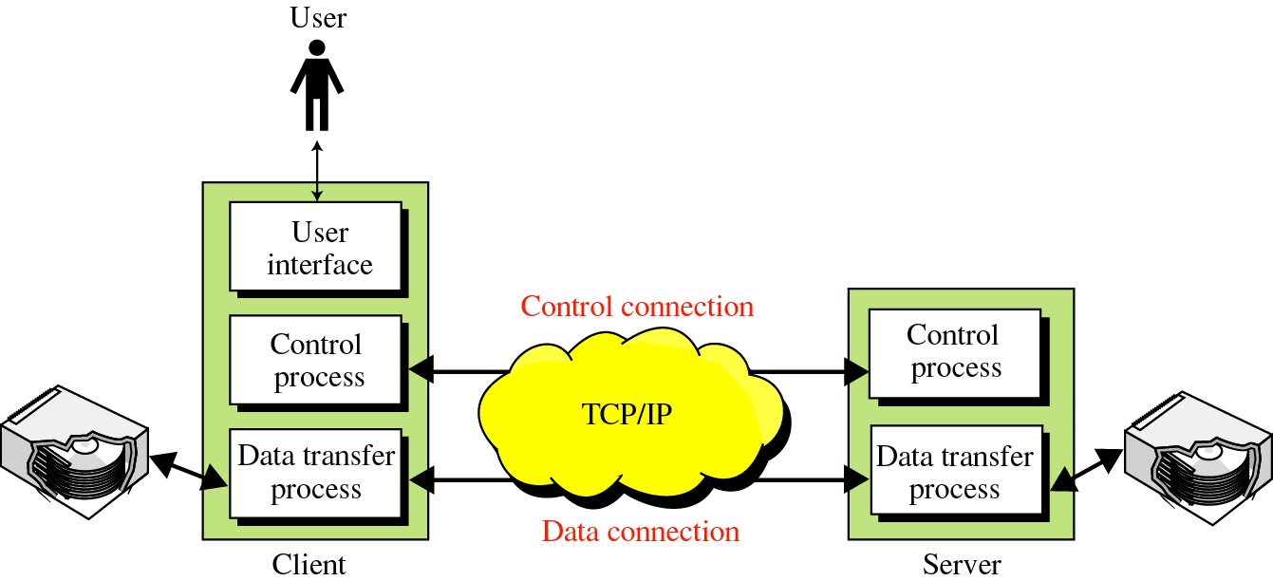
FTP

Slide 5
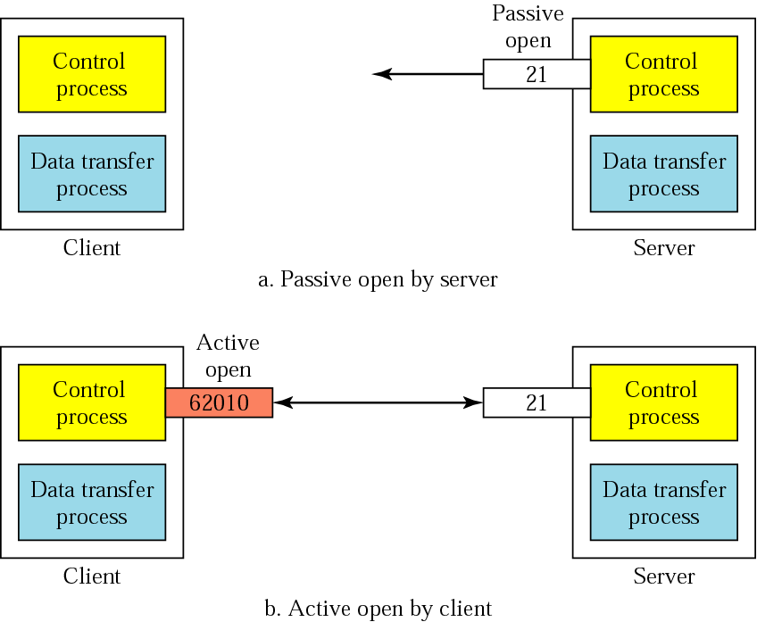
Connections: The control connection

Slide 6
The Data Connection
Uses Server’s well-known port 20
Client issues a passive open on an ephemeral port, say x.
Client uses PORT command to tell the server about the port number x.
Server issues an active open from port 20 to port x.
Server creates a child server/ephemeral port number to serve the client

Slide 7
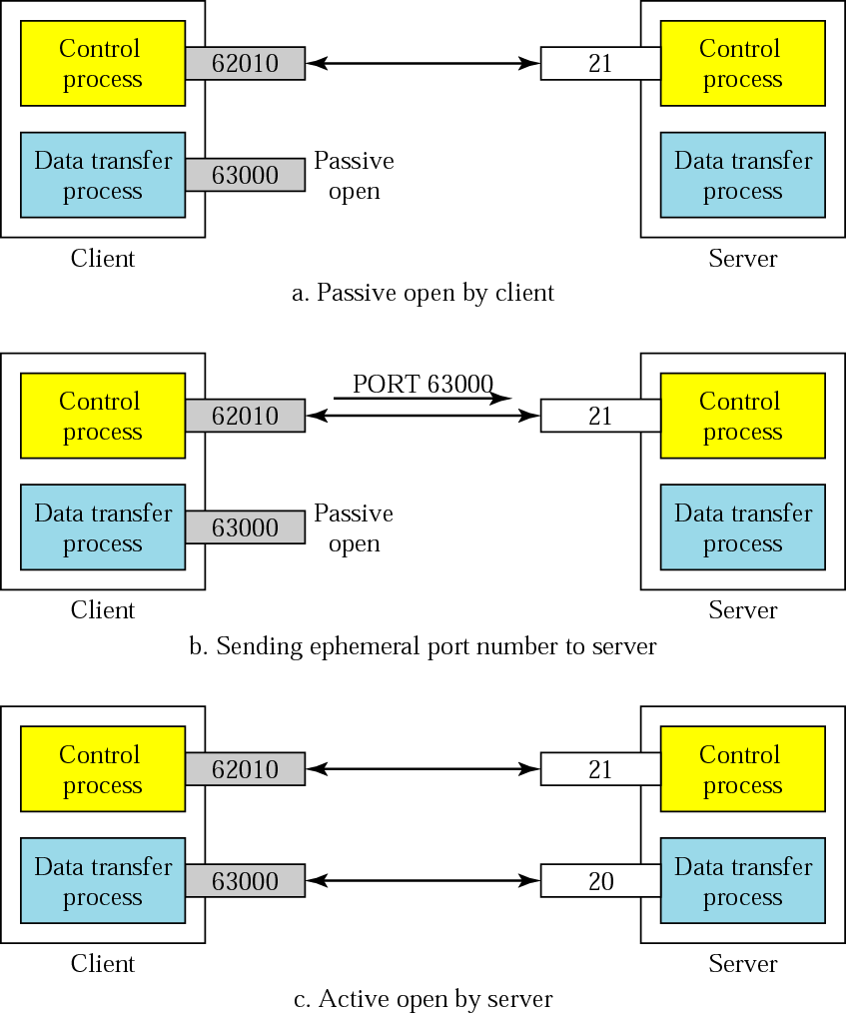
Creating
the data
connection

Slide 8
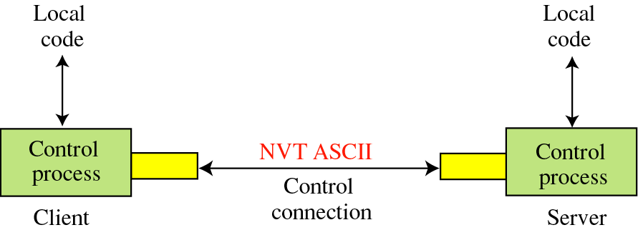
Communication
Using the control connection
Notes:
Network virtual terminal

Slide 9
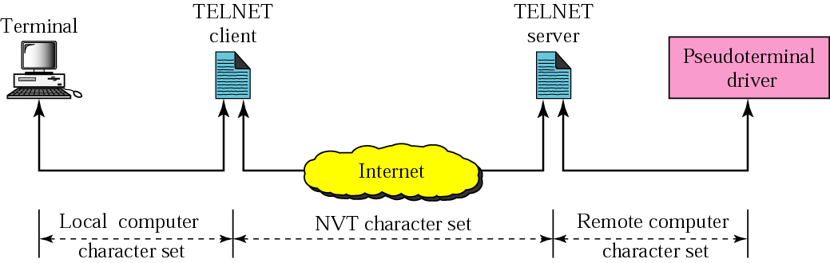
NVT
FTP
FTP

Slide 10
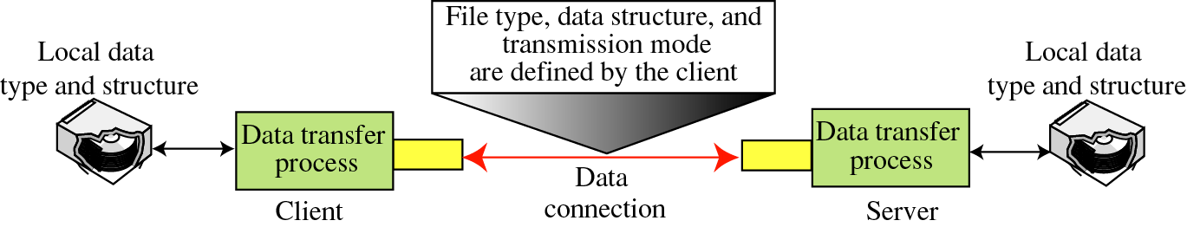
Using the data connection

Slide 11
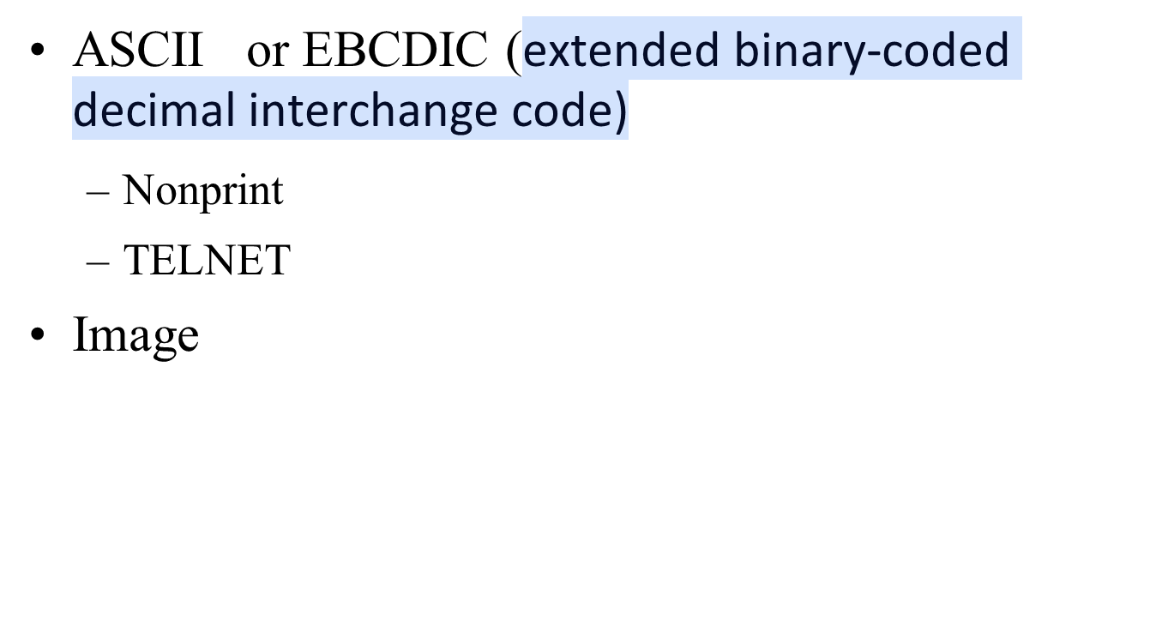
File Type

Slide 12
Data Structure
File Structure
Record Structure
Page Structure
The file structure format (used by default) has no structure. It is a continuous stream of bytes. In the record structure, the file is divided into records. This can be used only with text files. In the page structure, the file is divided into pages, with each page having a page number and a page header. The pages can be stored and accessed randomly or sequentially.

Slide 13
Transmission Mode
Stream mode
Block mode or Compressed mode
The stream mode is the default mode; data are delivered from FTP to TCP as a continuous stream of bytes. In the block mode, data can be delivered from FTP to TCP in blocks

Slide 14
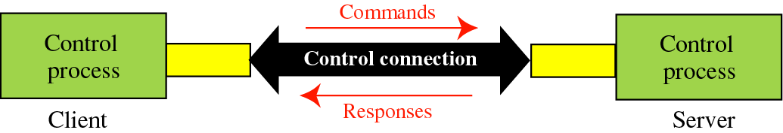
Command processing
Access Commands
File Management
Data Formatting
Port defining
File transfer
Miscellaneous

Slide 15
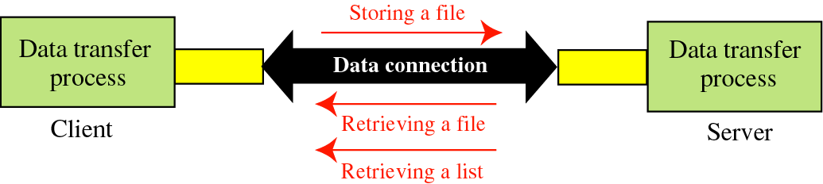
File transfer

Slide 16
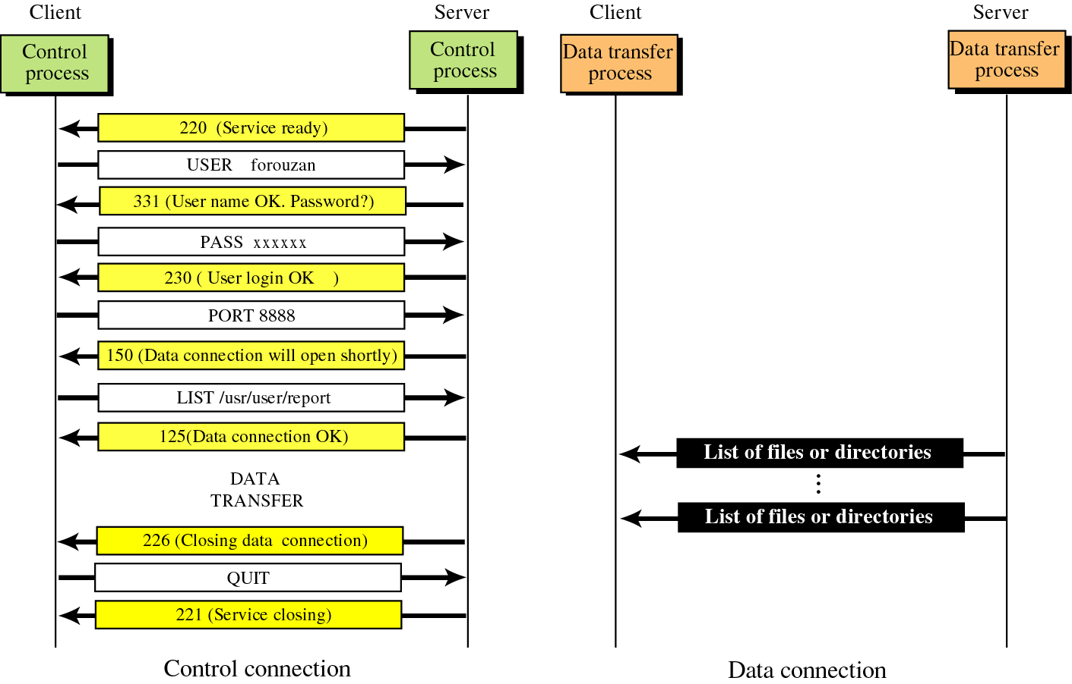
Example 1

Slide 17
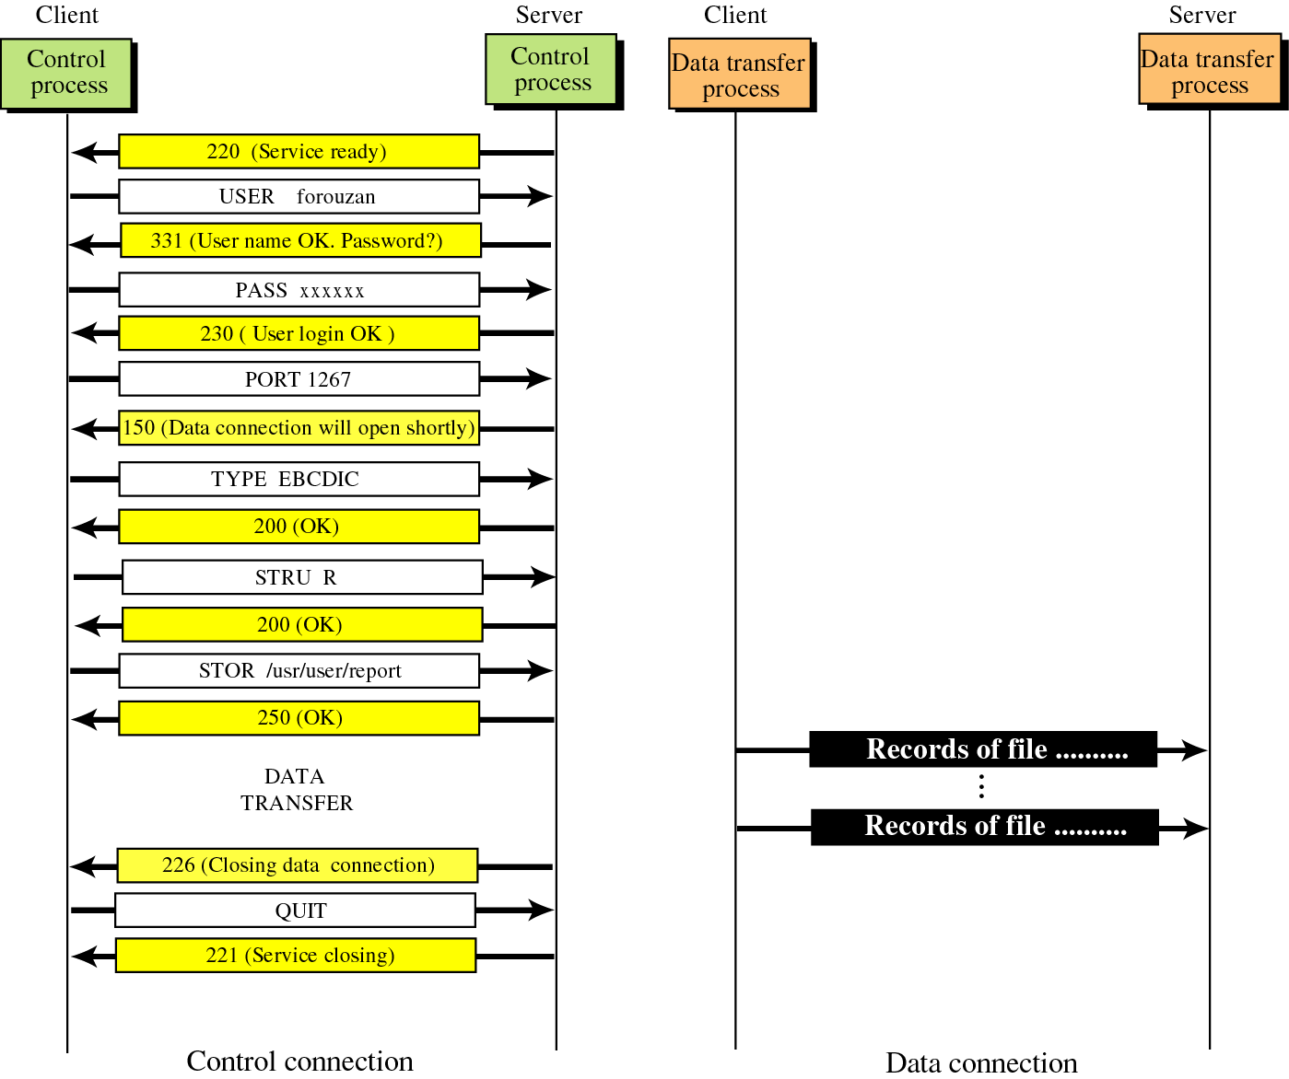
Example 2

